Slide 1

Raspberry Pi:
www.mwftr.com
EECE416 Microcomputer
Howard University
Dr. Charles Kim
Presented by:
Lakeasha Williams & Venessa Woodson

Slide 2
OVERVIEW
What is a Raspberry Pi Microcontroller?
RaspPi Software & Hardware
Project Explanation
Demonstration

Slide 3
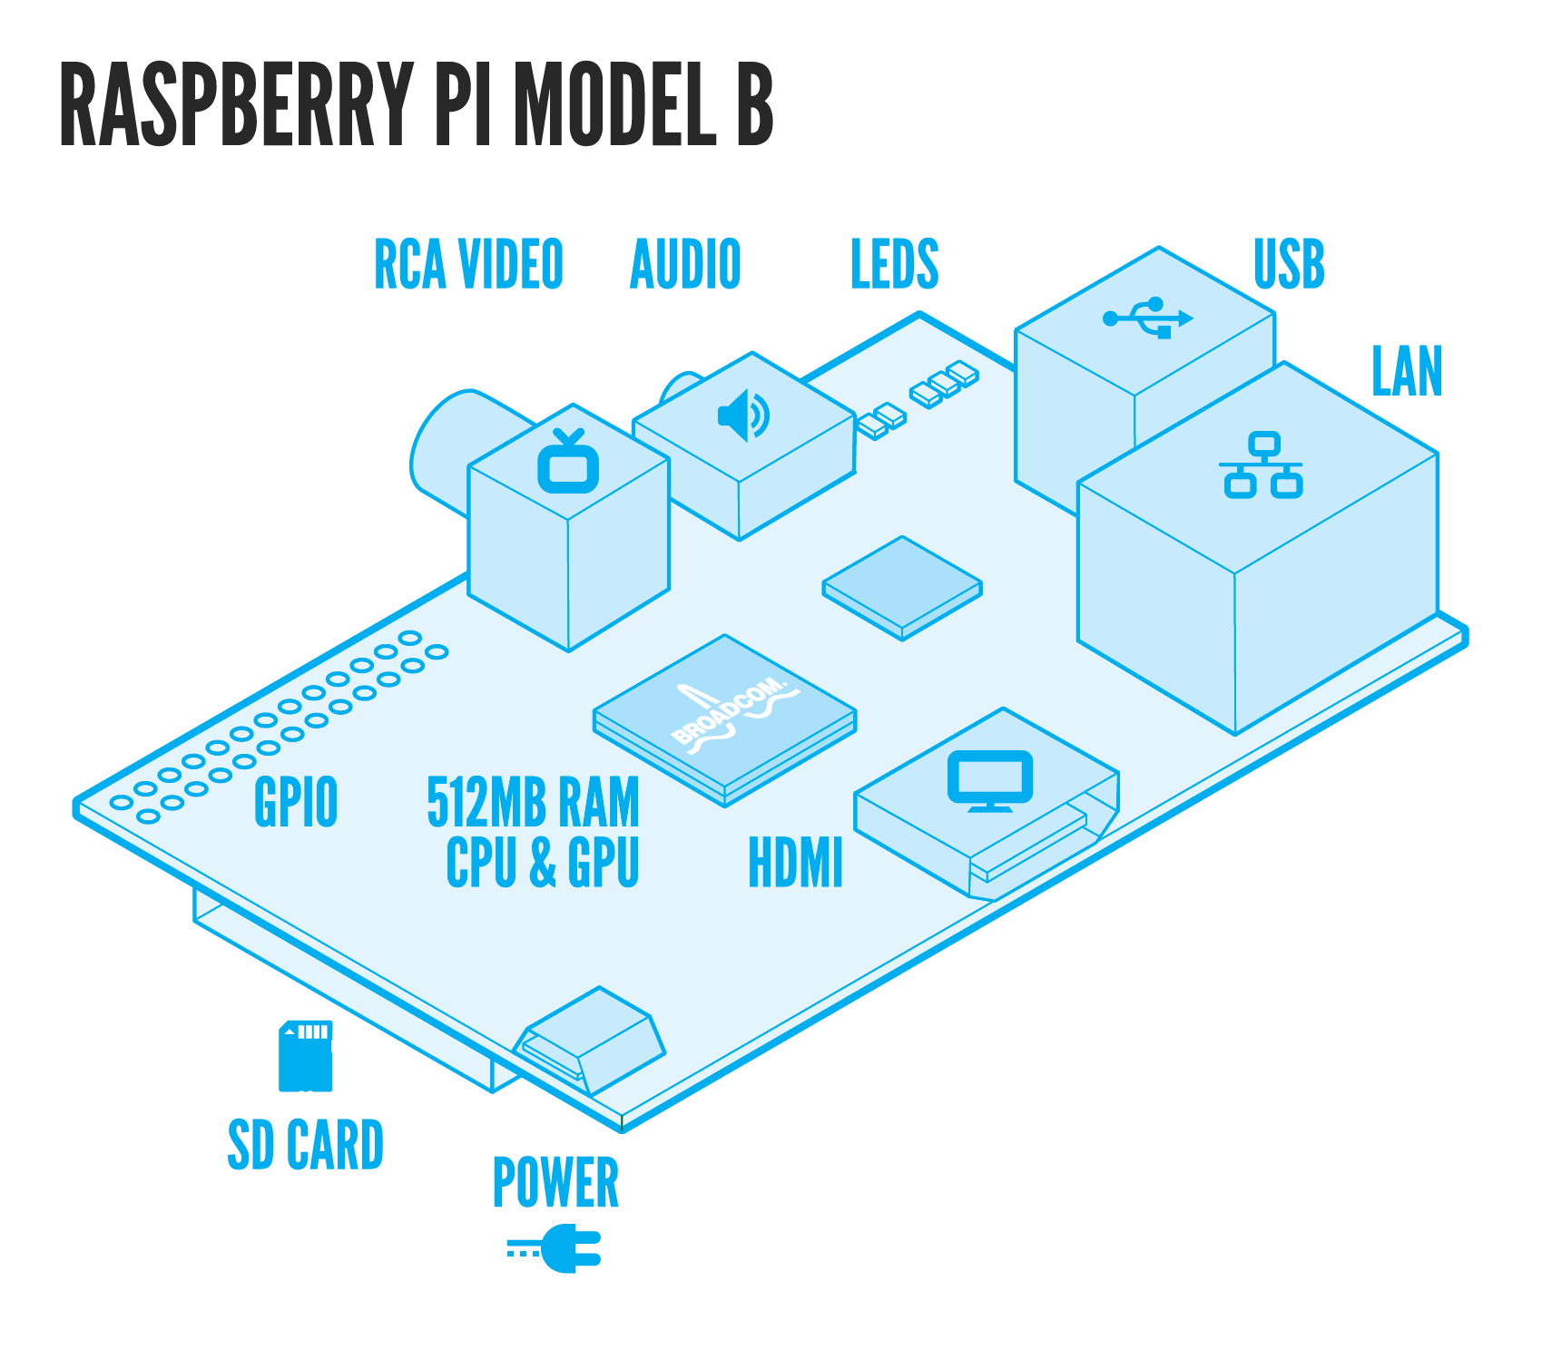
What is a Raspberry Pi Microcontroller?
Developed by Raspberry Pi Foundation in UK
Single board computer
Small, but very powerful
Can be used to make a arcade machine, camera, tablet computer, internet radio, robot controller, etc.
Python language recommended (C, C++, Java okay)

Slide 4
RaspPi Software & Hardware
SoC | Broadcom BCM2835
Ram Size | 265 MB or 512 MB
I/O Pins | 26
Voltage Requirements | 5 V via MicroUSB or GPIO header
Additional Components | SD Card Slot, HDMI port, Headphone Jack, Camera Interface
Size | 3.4 x 2.1 inches (credit card size)
http://en.wikipedia.org/wiki/Raspberry_Pi

Slide 5
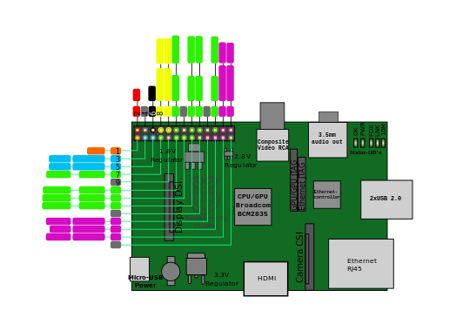
RaspPi PIN LAYOUT
http://en.wikipedia.org/wiki/File:Raspberrypi_pcb_overview_Pinout_v01.svg

Slide 6
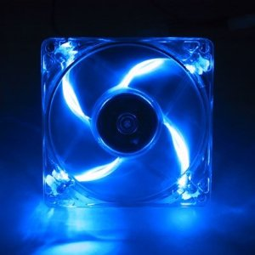
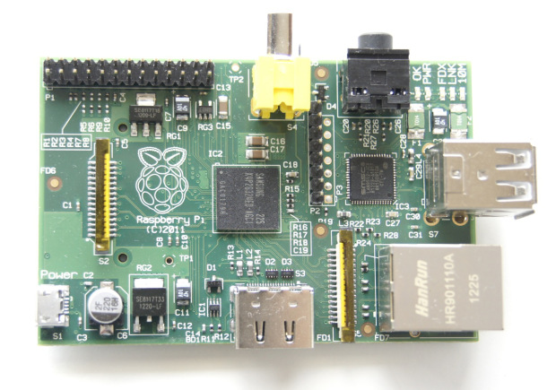
PROJECT EXPLANATION
Turn a 12V PC LED Fan on using the Raspberry Pi

Slide 7
DEMONSTRATION

