Slide 1


HATE CRIME PREDICTOR
BY TEAM: SOCIAL SPHERE MACHINE
Notes:
This presentation, is going discuss our hate crime predictor and how it will have an impact in society. This project carried out by team social Sphere Machine, led by Dr. Charles Kim at Howard University.

Slide 2
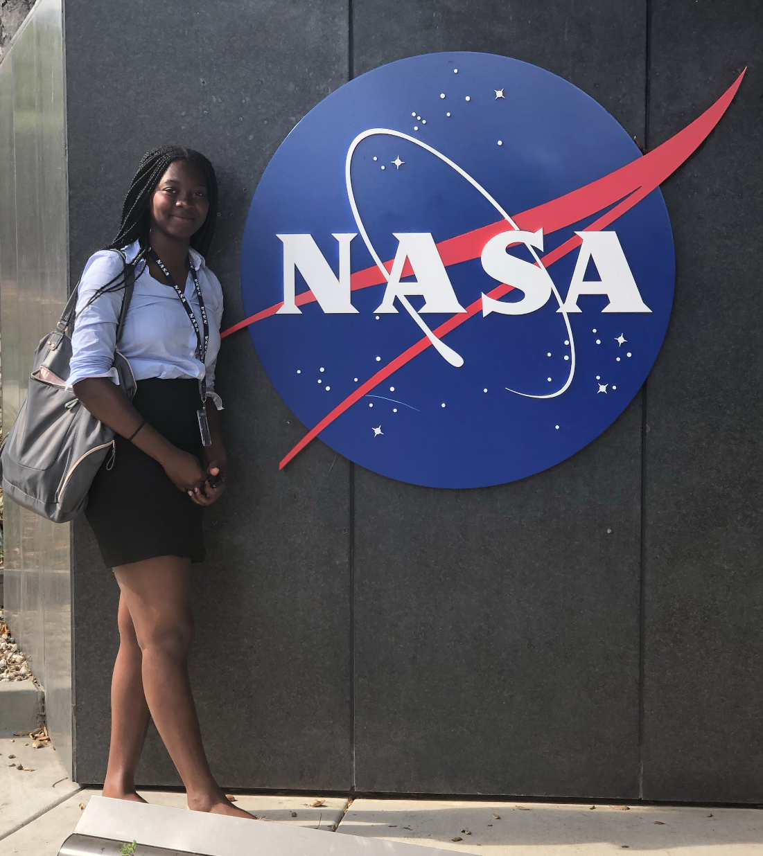
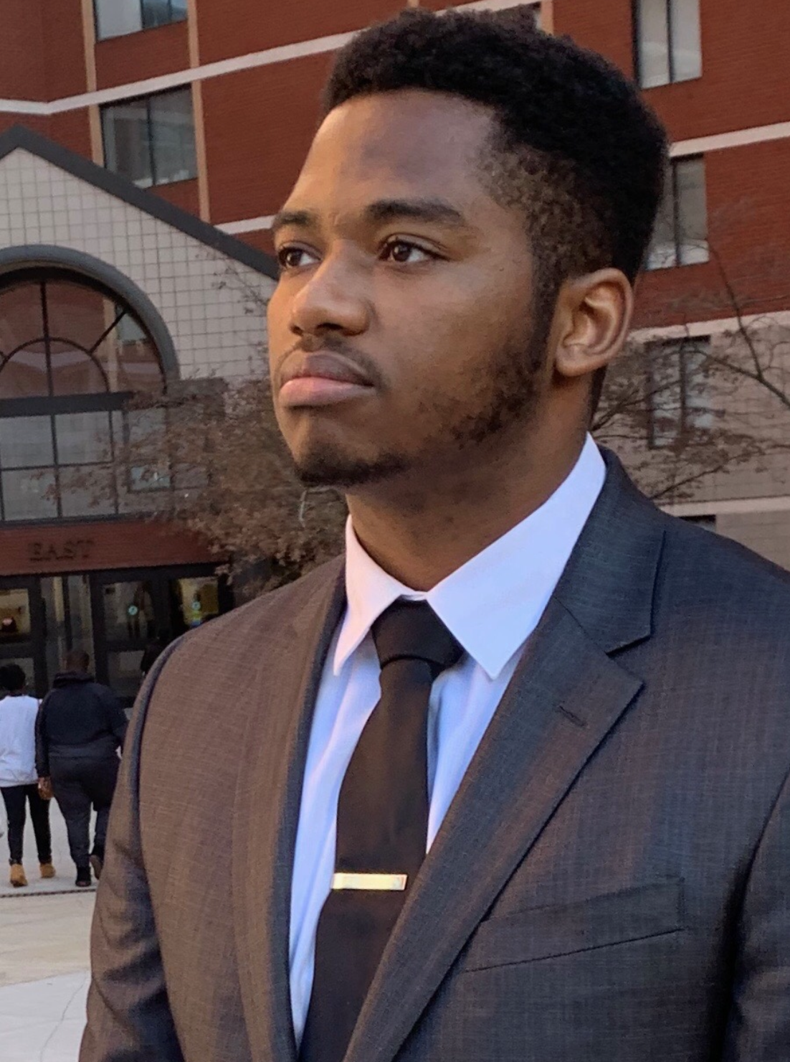
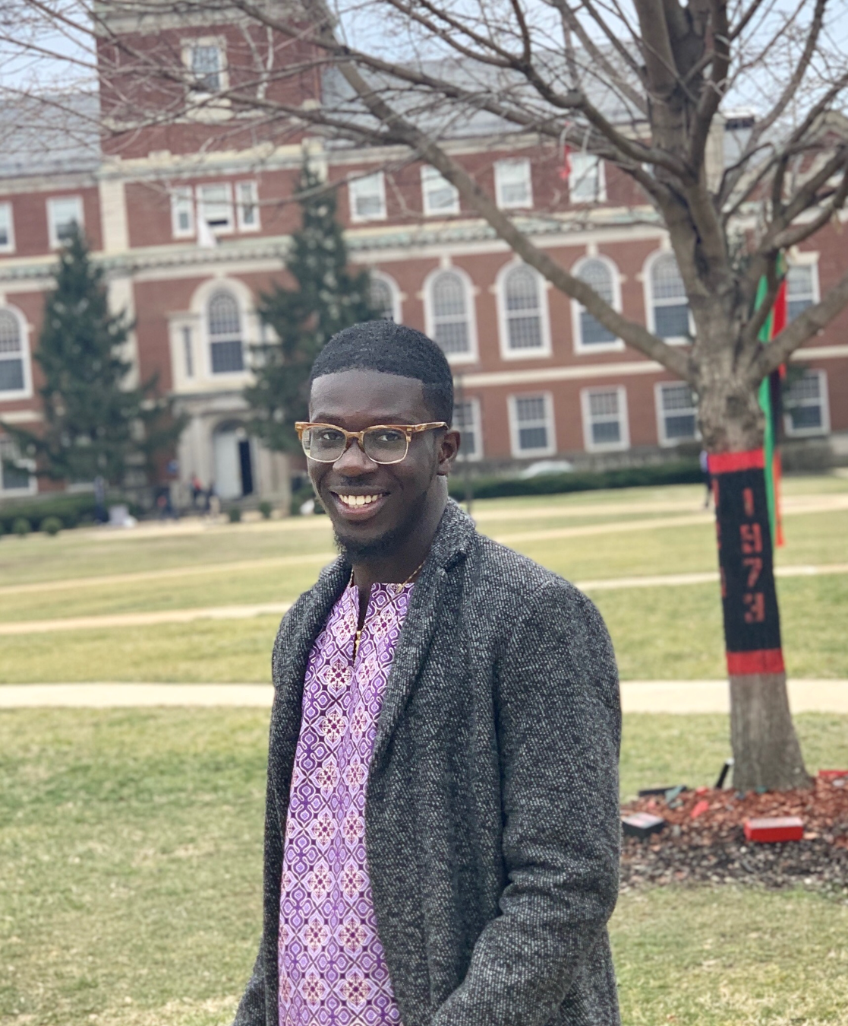
SOCIAL SPHERE MACHINE
Notes:
The undergraduate's students behind this project from left to right is Nana-Akua Ofosu is a Junior computer engineering student, Terron Rose is a Junior electrical engineering and Jedidiah agbenu is a Junior computer engineering major as well

Slide 3
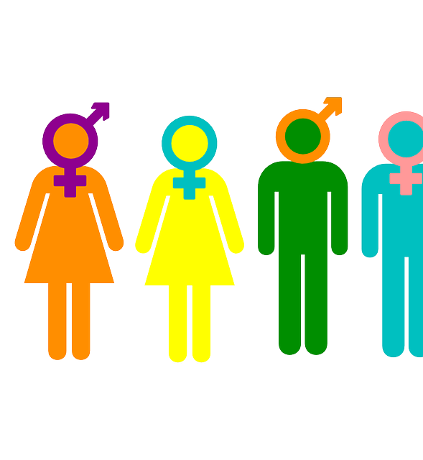
HATE CRIME
Hate crime is criminal offense against a person or property motivated in whole or in part by an offender’s bias against:
  Race
  Religion
  Disability
  Sexual orientation
  Ethnicity
  Gender
  Gender identity
Notes:
A Hate crime is criminal offense against a person or property motivated in whole or in part by an offender’s bias against somebodies' race, religion, disability and or gender identity. Hate speech is abusive form of speech or writing that expresses prejudice against the same types of group.

Slide 4
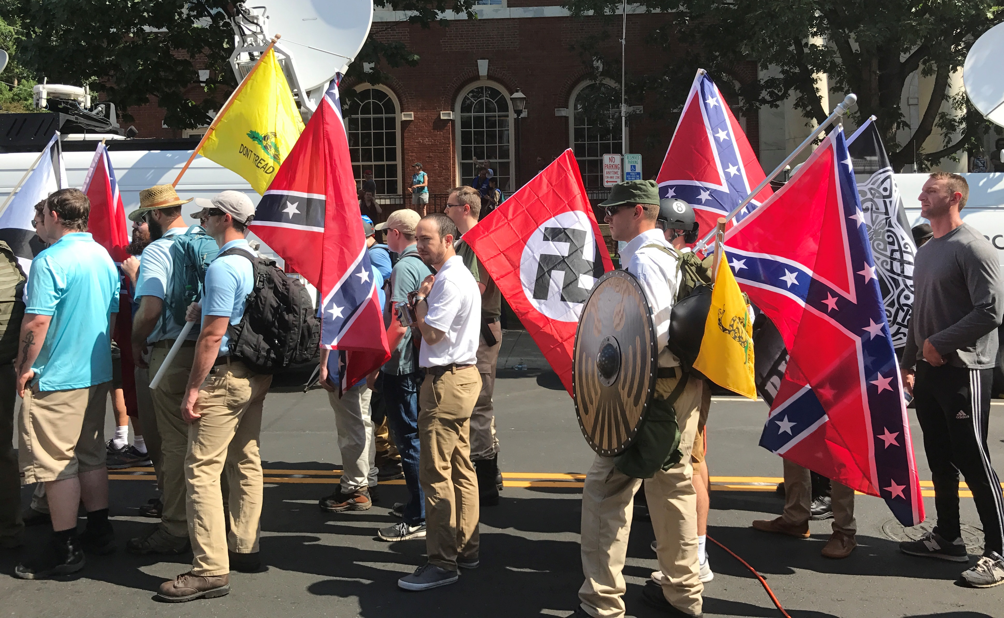
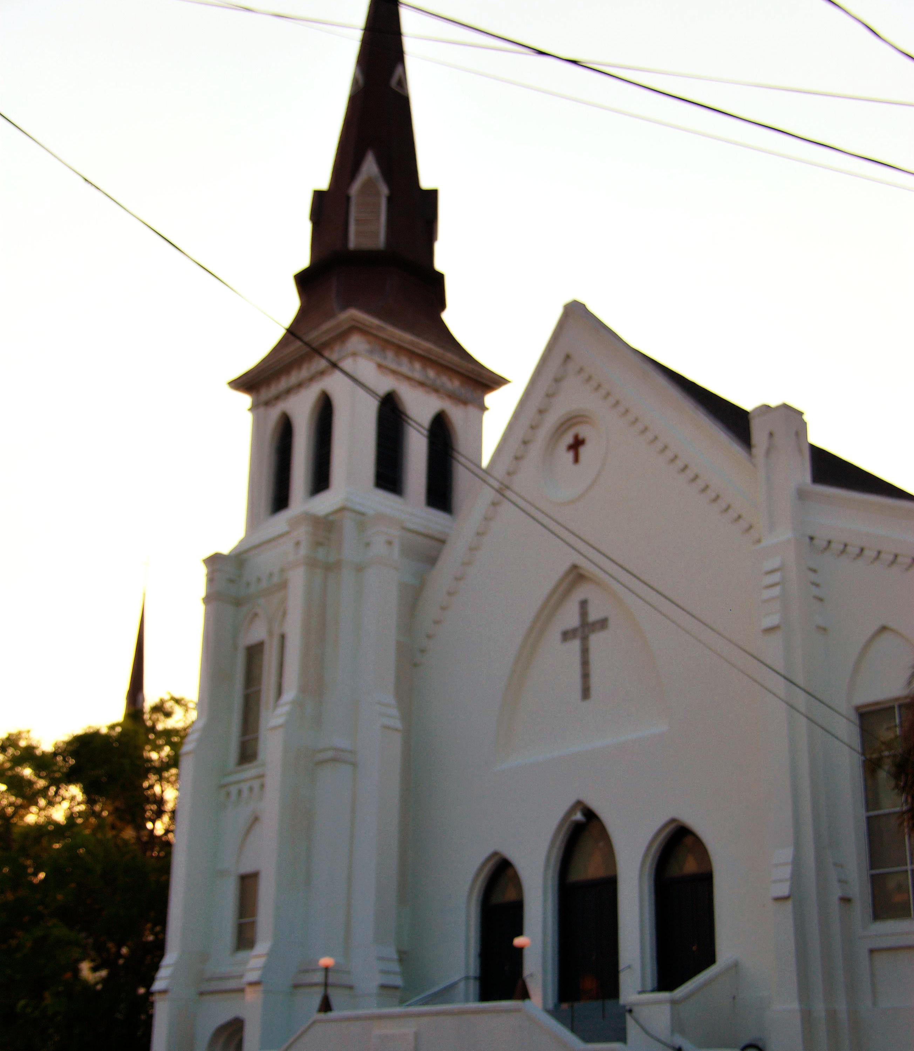
Past Hate Crimes
The Charleston Church Shooting
A mass shooting that was committed by 21 year old Dylann Roof, in which Roof murdered 9 African Americans during a prayer service.
Unite The Right Rally
A white supremacist rally that occurred in August 2017 in Charlottesville, Virginia that revealed a lot of racist and antisemitic slogans that we could use in our project
Notes:
These two events occurred in 2017, were both racially motivated,
and were preceded by posts on social media and blogs.
These social media posts and uploads to the internet can
be used to possibly predict and prevent such tragedies from
occurring.

Slide 5



WHAT WE ARE TRYING TO DO
To find a correlation between hate speech online and hate crime
WHAT WE BELIEVE:
  There is a positive correlation between hate speech online and hate crime
Notes:
Based off of multiple crimes similar to the ones discussed before we came to the consensus that there is strong correlation between hate speech posted online and hate crimes. More specifically we believe that the more a user posts hate speech online against a group of people the more likely they are to commit that hate crime against that group.

Slide 6

HATE CRIMES TODAY
Right now hate crimes are in a more responsive manner than a preventative manner
LIMITS:
Does not prevent people from being in dangerous situations
Notes:
Hate Crimes today are handled in a more responsive manner. What we mean by manner is that they are mostly dealt with after the crime has been committed. This is limiting because it does not protect people from being in dangerous situation LEADING TO POTENTIAL PREVENTABLE DEATHS.

Slide 7

OUR APPROACH TO HATE CRIMES
The approach:
  To use Social Media to help make our predictions
Why it will be successful:
  Linguistic and motor systems are strictly “tied up”
Notes:
What we are trying to do is build a statistical learning model that will able to prove our belief that there is a strong positive correlation between hate speech and hate crime. This model will model will be useful in today’s climate because of the increase trend of interpersonal violence. We believe that our tool will be useful because according to many neuroscientist linguisticS and motor systems are strictly “tied up”.

Slide 8
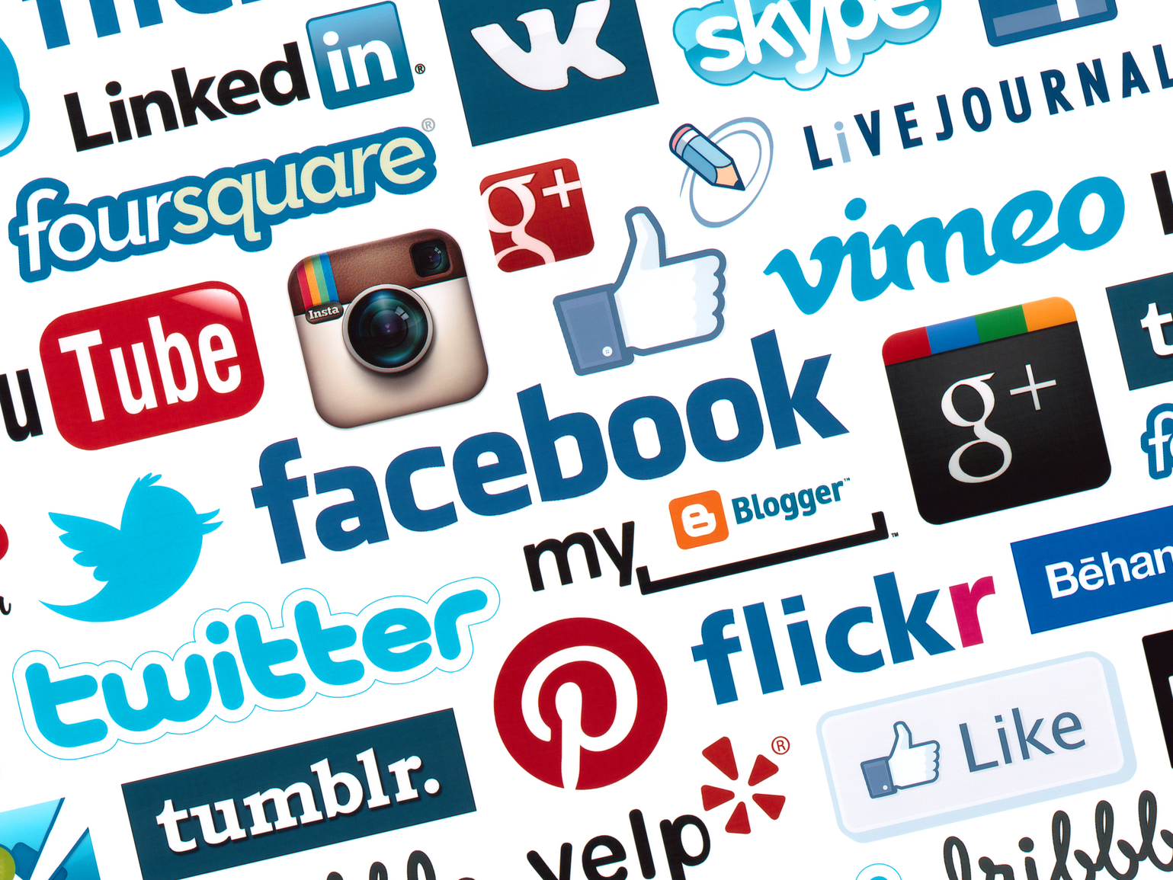

Increased usage of social media
Why Social Media:
Social media platforms are used by one-in-three people in the world
There will be enough data to see some trends
This Photo by Unknown Author is licensed under CC BY-NC
This Photo by Unknown Author is licensed under CC BY-SA-NC
Notes:
So many people are on social media or using the internet today, and furthermore a lot of people's feelings, and even actions are first manifested on social media posts and/or user created content that is uploaded to the internet
(Tie it to how that usage means there will be various amount of data that allows us to see clear trends) 3.5 billion of 7.7 billion people are ON ONLINE

Slide 9

VARIOUS API’s
We are planning to use:
  Twitter
  Reddit
  Blogger
  Other Google Databases
  Hate Blogs
Notes:
We will also use various apis to gain access to user created content that will also give us insight to which words are the most relevant to the occurrence of hate crimes. To use API’s that are popular for grouping individuals such as social media. We also plan to use API’S from websites that do not filter HATE SPEECH to eventually be see if there is a trend between hate speech and hate crime.

Slide 10
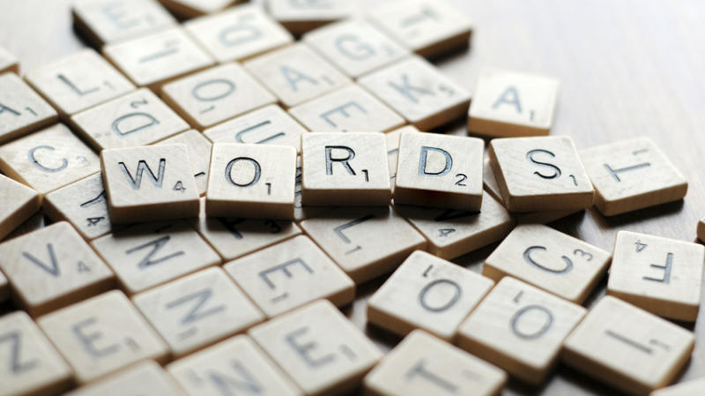
THE WORD BANK
We will create a word bank based on the top 50 words
Most of the words will be collected from the hate blogs
This Photo by Unknown author is licensed under CC BY-SA.
This Photo by Unknown Author is licensed under CC BY-SA-NC
Notes:
This Word Bank is a collection of 50 words that we believe we serve as the best predictors of hate crimes. We plan to create this word bank by first finding hate grouped websites like the KKK’s website and running their pages through the WORD FINDER. From there we plan to look through psychology scholarly journals to figure out trends between speech and actions. From that research we plan to expand our word bank. The word bank is the most crucial part of our project because the words will determine the trends that we see.

Slide 11
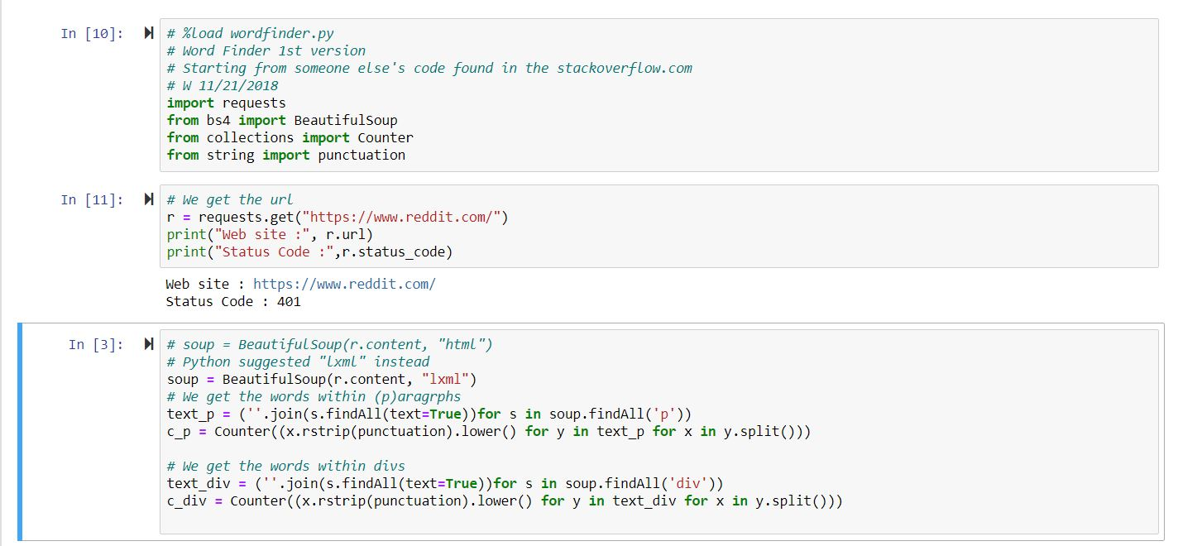
WORD FINDER CODE!!
Notes:
This is the beginning of one version of our wordfinder code that uses an HTML parser library known as beautiful soup. We will use this to develop the word bank for our statistical learning method. The input for our wordfinder code is a url, and one of our possible outputs will be displayed on the next slide.

Slide 12
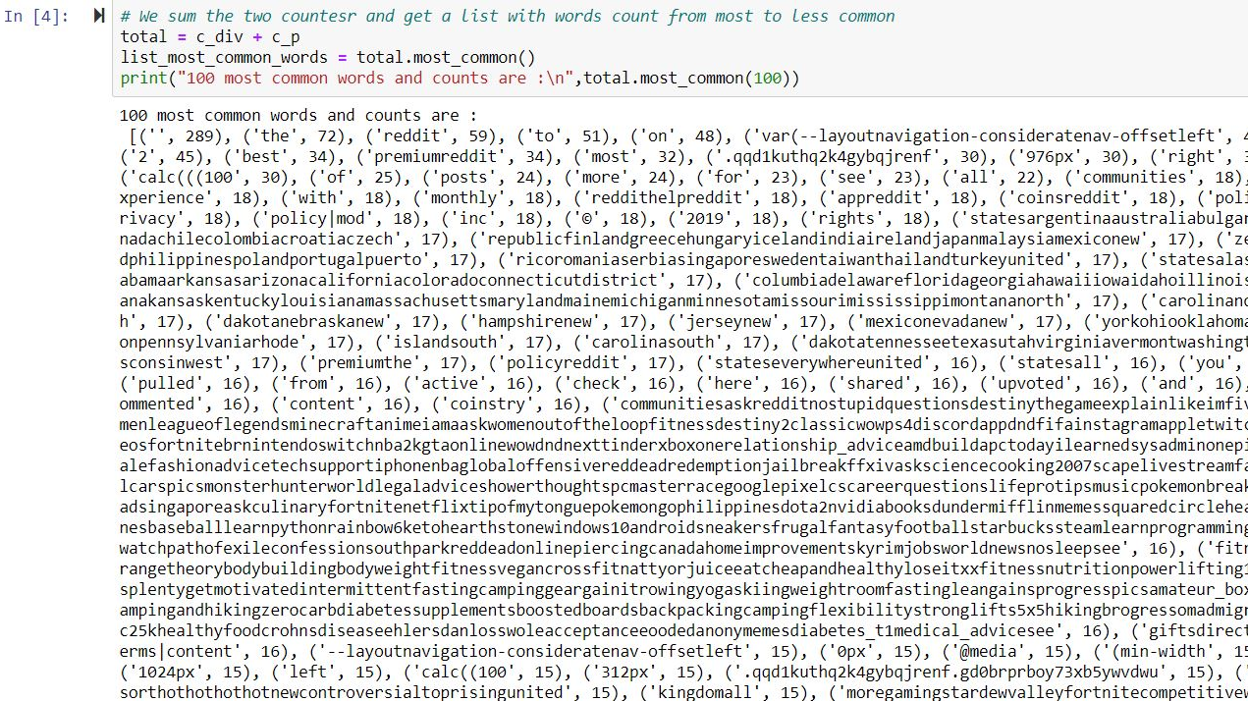
WORD FINDER OUTPUT
Notes:
This is an example of the output of our wordfinder code, in which our input is the url for any particular website, and the code can either give us the most common words that occur on the website, or how many times a particular word occurs.

Slide 13

WHO IT WILL BENEFIT?
  Police Departments
  Department of Justice
  Human Rights Groups
  FBI’S Civil Rights program
  The Human Race
This Photo by Unknown Author is licensed under CC BY-SA
Notes:
Many government PROGRAMS will benefit from the hate crime predictor. In fact Hate crimes are the highest priority of the FBI’s Civil Rights program due to the devastating impact they have on families and communities. Other organizations that are not affiliated with the government will benefit too because they do not their life could easily be affected from these crimes.

Slide 14

HOW THIS PROGRAM WILL HELP
Allow for the timely prediction of future hate crimes
Can increase the safety of people across the world.
Notes:
This program will help the beneficiaries discussed earlier because it will allow for the timely prediction of future hate crimes. This is important because these crimes are time sensitive. This predictor can increase the safety of people across the world because it will update its trends daily.

Slide 15
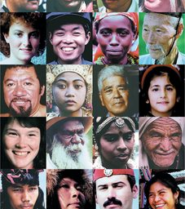
Who's affected by hate crime?
The Human Race
The trends show more violence, more interpersonal violence
This Photo by Unknown Author is licensed under CC BY-SA
This Photo by Unknown Author is licensed under CC BY-NC-ND
This Photo by Unknown Author is licensed under CC BY-NC-ND
Notes:
Hate crimes can affect any group on the face of the Earth, so this means that not only one group isolated by the tragedies that hate crimes can cause. This is why if we can predict the occurrence of hate crimes, the entire world will be safer.

Slide 16

WHAT ARE THE RISKS?
Compromising user privacy by using social media APIs
This Photo by Unknown Author is licensed under CC BY
Notes:
The only risk with our project is compromising user privacy. However when we were requesting access to various APIs, we had to confirm that we won’t be using user data for personal use, or reposting data or user created posts in any form or fashion.

Slide 17
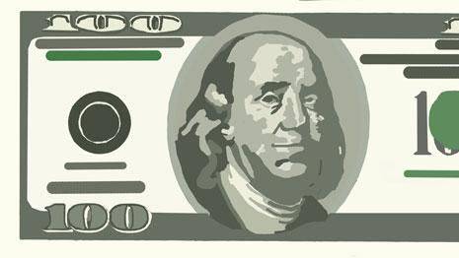
HOW MUCH IT WILL COST
Twitter Standard Search API is free
Higher Access API’S:
  $149/month to $2,499/month
Notes:
Our cost are solely dependent on API’s. Just recently we gained access to Twitter's standard search API, which granted us access to tweets published in the last few days. There are other packages, however, that requires more extensive access to user created content, for a fee of course.

Slide 18

HOW LONG IT WILL TAKE?
It is dependent on how long we want to collect data for:
  30 days
  60 days
  3 months
The actual program will take seconds to run
This Photo by Unknown Author is licensed under CC BY-SA-NC
Notes:
The longest part of this project is creating a database to test our statistical learning model. It can take any where from 30 to 365 days depending on how big we want our database to be before we test it. However after the database has been made the program will take seconds to run and compute trends.

Slide 19
WHAT ARE THE GOALS?
GOAL 1:
Collect data over a period of time
GOAL 2:
To create statistical learning model to visualize the trends between the occurrences of words and actual events
GOAL 3:
Is to look into some previous hate crimes and see if our statistical model is accurate enough to predict those events
Notes:
Our goals for this year is to first
Collect data over a period of time
After collecting the data we plan to
To create statistical learning model to visualize the trends between the occurrences of words and actual events
Finally after creating that model we plan on testing the accuracy of the tool by
looking into some previous hate crimes and see if our statistical model is accurate enough to predict those events
rst

Slide 20
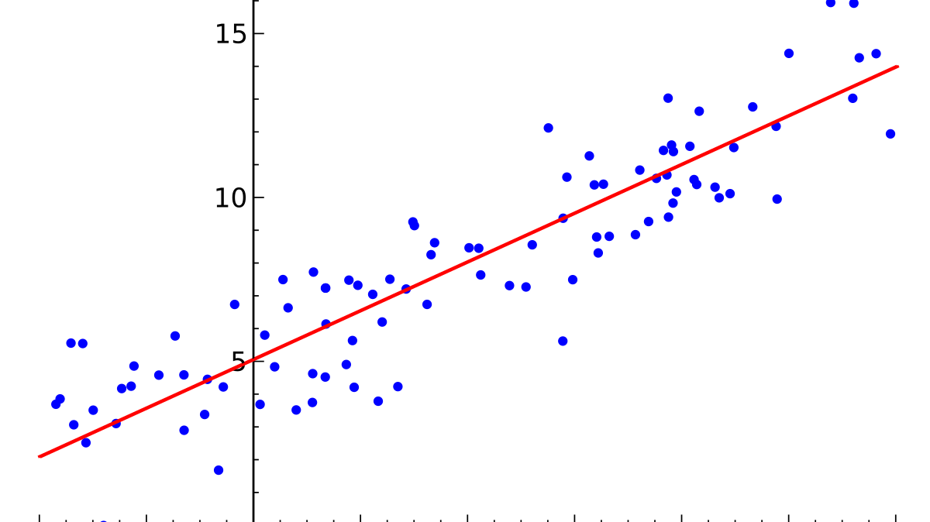
Continuous work and Final Product
The Current product:
Right now we have a word finder that can count the occurrence of a word or phrase on a website
The Final product:
Is to create a statistical learning model that could be applied to various types of crime
This Photo by Unknown Author is licensed under CC BY-SA
Notes:
Currently We have a word finder that can count the occurrence of a word or phrase on a website. We plan on create our final product by utilizing R code to a graph the frequency of word occurrence over a specific time. That graph would provide us with information to be able to predict the likelihood of the next crime. Eventually we plan to create a statistical learning model that could be applied to various types of crime. This social spear machine will make the word a better place.

