Slide 1
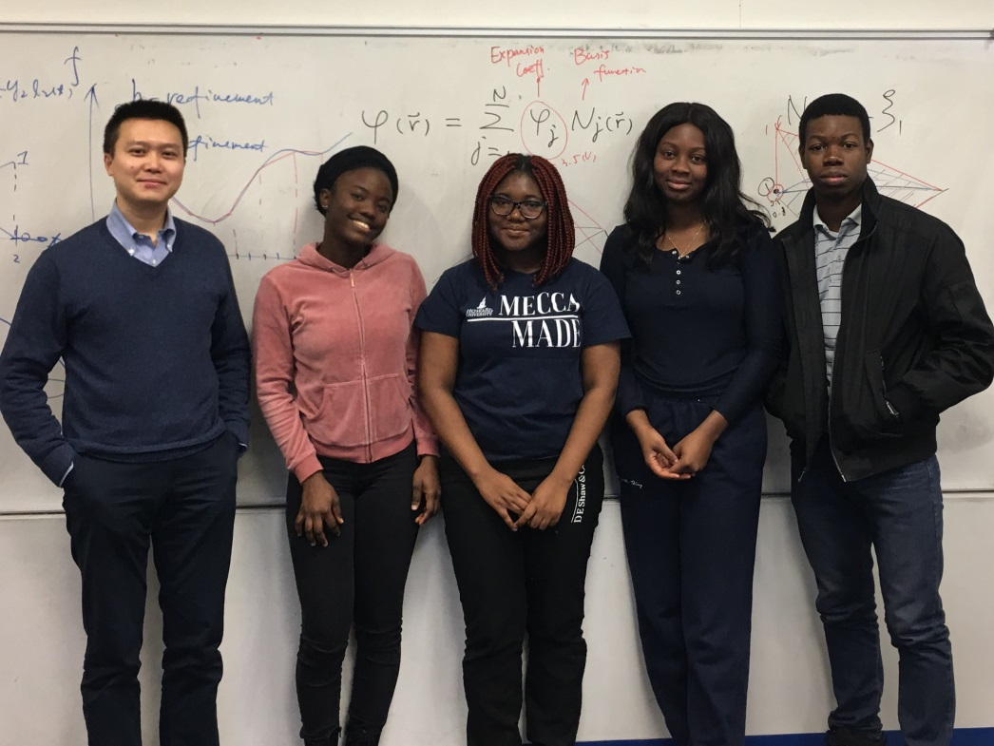

Howard University VIP Team
Electromagnetic Virtual Playground
Faculty Advisor
Dr. Su Yan
Team Members
Faith T. Adegbenro (EE, Junior)
Olaide R. Afolabi (EE, Junior)
Nana-Akua Ofosu (CpE, Senior)
Oluwatamilor E. Ogunbanjo (CpE, Junior)
Javid Mitchell (CS, Freshman)
Notes:
In this presentation, we are going to introduce our VIP project, the electromagnetic virtual playground. This project is conducted in Howard University, under the supervision of Dr. Su Yan. Currently, we have five undergraduate team members, Faith, Olaide, Nana-Akua, Oluwa, and Javid.

Slide 2
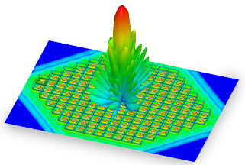
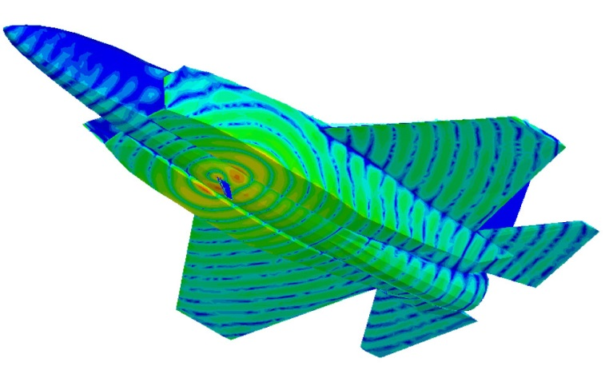
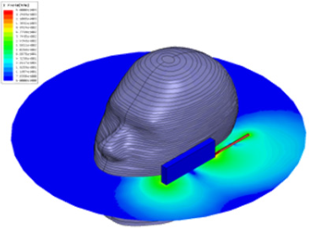
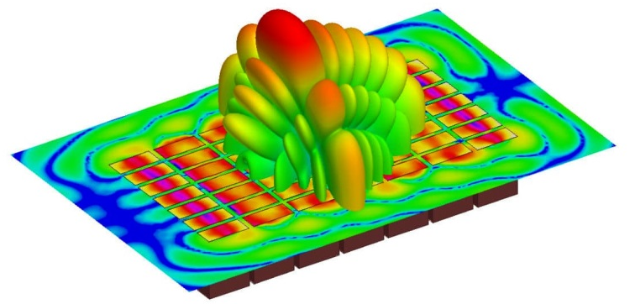
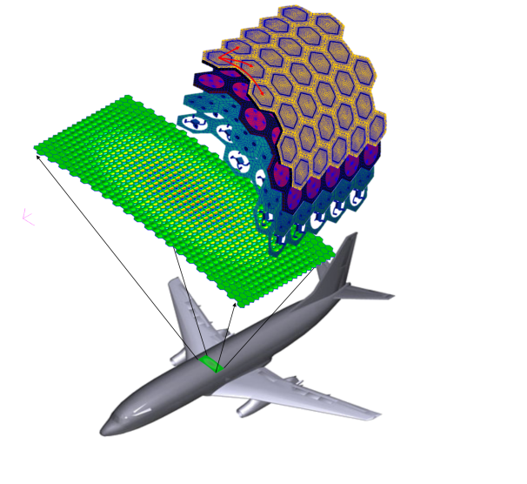
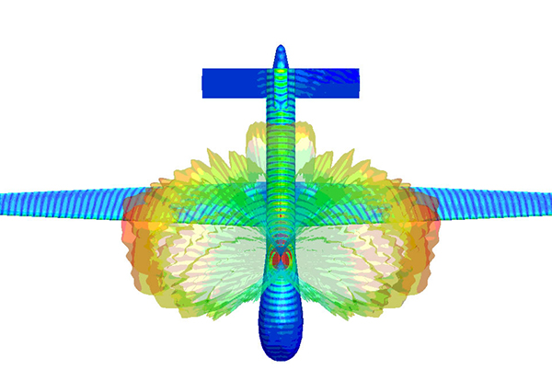
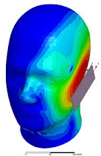
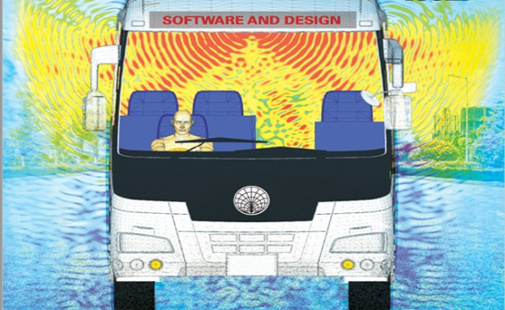

Electromagnetics (EM)
EM has Many engineering applications.
Notes:
As well known, electromagnetic theory has not only scientific significance, but also many engineering applications, including antenna design, radar system, wireless communications, electronics, and biomedical applications.

Slide 3
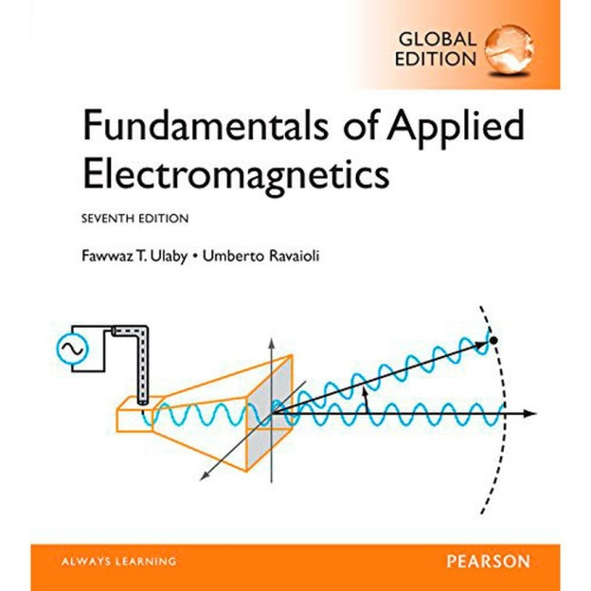
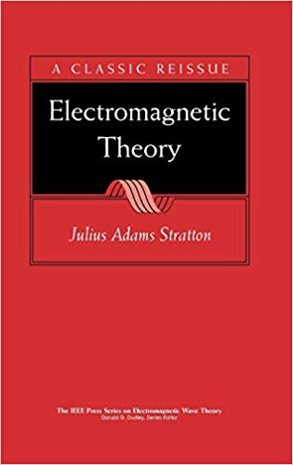
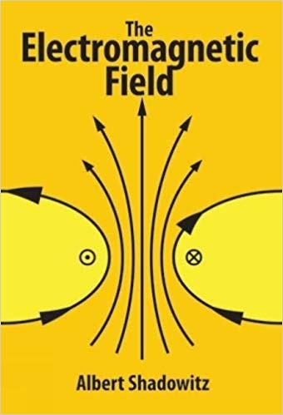
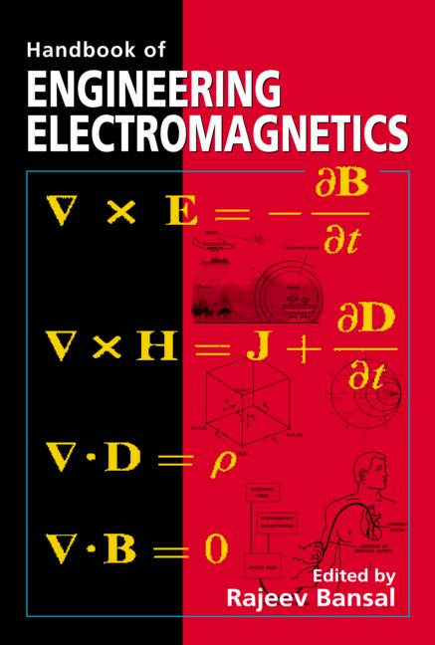
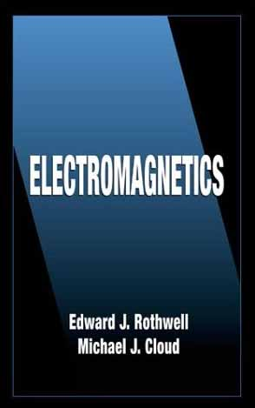
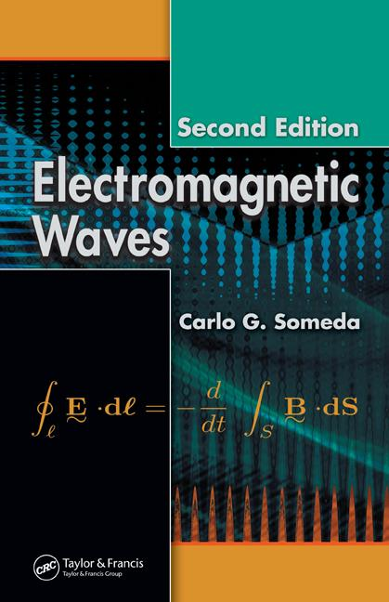
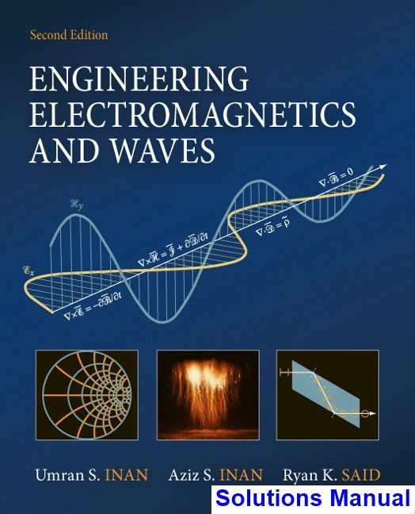
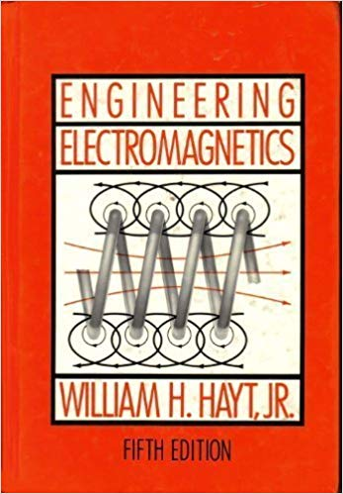
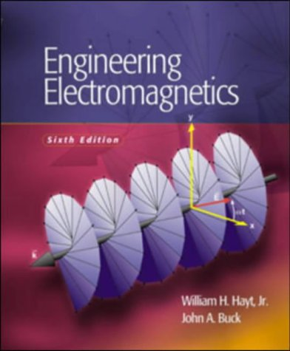
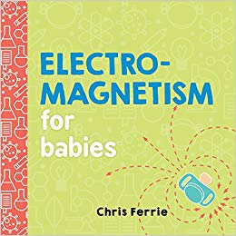
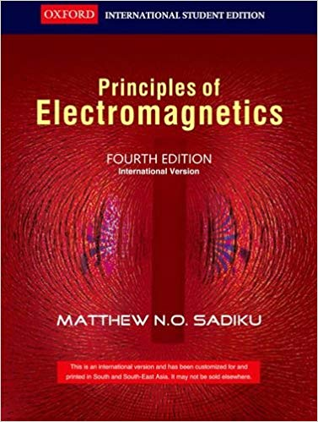
EM Theory as a Fundamental Course
In all universities and colleges
For undergraduate students and
Graduate students
Notes:
That is why electromagnetic theory is a required course in all universities and colleges for EE and CpE majored students.

Slide 4
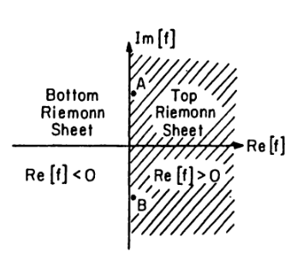
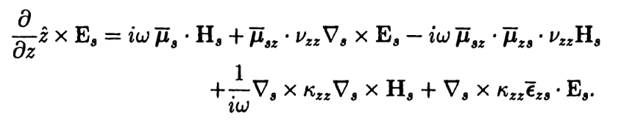

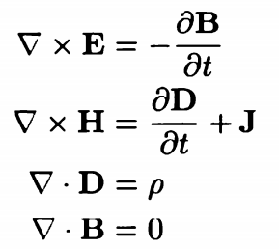
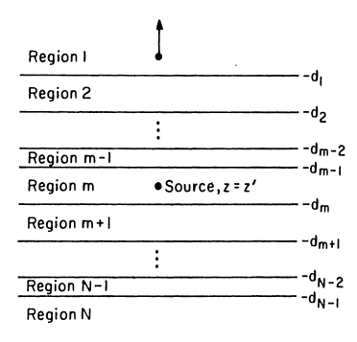
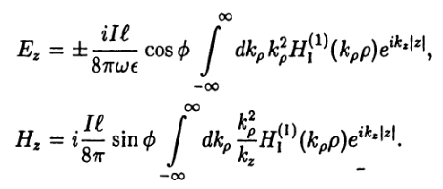
EM Theory
IS
Difficult
Notes:
Unfortunately, EM theory is very difficult to comprehend, especially for undergraduate students, due to the high requirements of mathematical mastery and physical understanding.

Slide 5
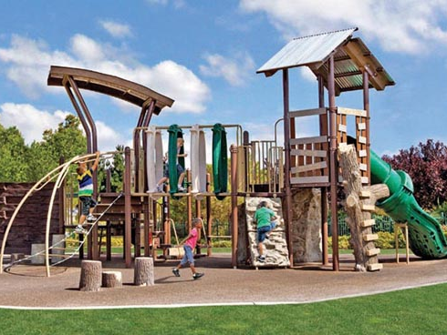
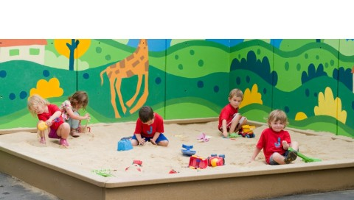
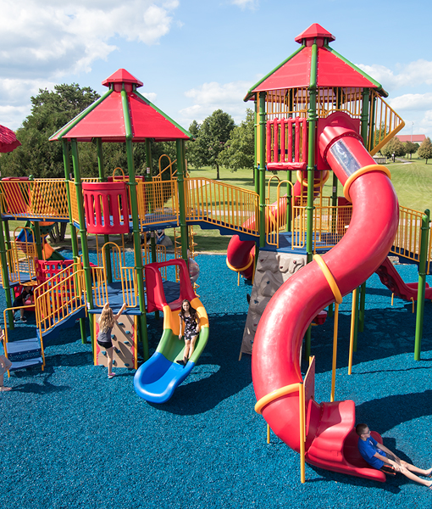
Our philosophy
—————————
Learning in Playing
Notes:
This motivates us to put together an effort in developing a tool that integrates learning with playing.

Slide 6
The Overarching Goal
To design, implement, and release an educational tool for EM study;
To help students gain a deeper understanding of EM physics;
To motivate and promote learning in electrical engineering related areas;
To promote interdisciplinary learning and collaboration.
What are we trying to do?
Notes:
In this effort, we will design and implement an EM virtual playground for educational purposes to help students gain deeper understandings of EM physics by performing virtual experiments and visualizing the physical fields on computers. This will greatly stimulate the study interests and promote interdisciplinary collaboration.

Slide 7
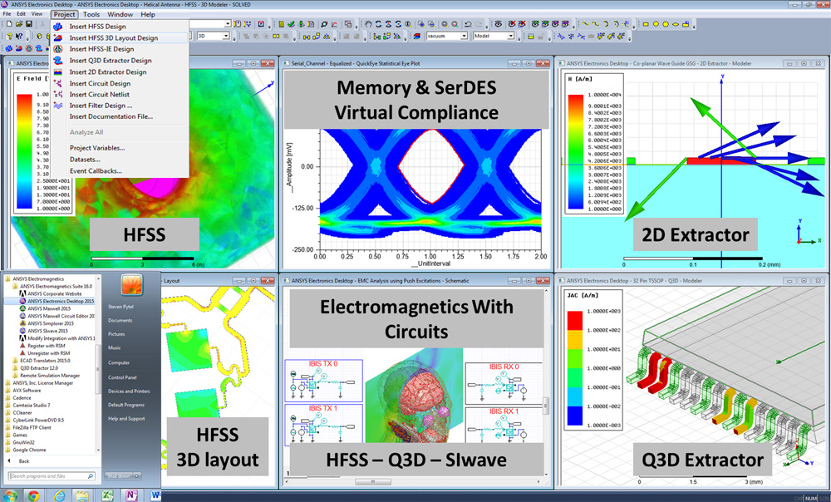
The Status Quo
Commercial simulation softwares:
  Available on the market;
  Expensive: Not accessible from students;
  Sophisticated: Designed for experts; Very hard for beginners/students to use;
Educational softwares:
  Very few: Limited options;
  Internal use only: Not accessible to general public.
How is it done today?
Notes:
Currently, such a tool is not easily accessible or usable for most students. One the one hand, commercial softwares are expensive and too complicated to use. On the other hand, similar educational tools are very few and are mainly for internal use only.

Slide 8
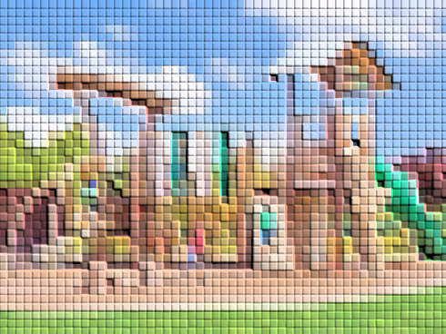
EM Virtual Playground
—— What is new about our approach
Accessibility:
  Freely available to students;
  Will be made an open resource for the general public;
Usability：
  Parallel to the course contents;
  User friendly;
Flexibility:
  Expandable: More functionalities/features can be added when needed or upon request;
  Portable: Different OS; Online/Offline; Desktop/Mobile.
Notes:
Therefore, our goal is to develop such an educational tool that offers accessibility, usability, and flexibility to the end users, our undergraduate and graduate students, not only at Howard University, but also publicly accessible from the outside.

Slide 9
A Top-Down Design
Foreground
Graphic User Interface
Experimental Settings
Result Display
Background
Computational Engine
Static Field
Message Output
Radiation
Propagation
Reflection
Refraction
Diffraction
Scattering
Notes:
This toll is designed in a top-down fashion, which contains two major components: a foreground GUI where users can set up a virtual experiment and visualize the physical results, and a background engine where the scientific computing takes place to carry out the experiment numerically.

Slide 10
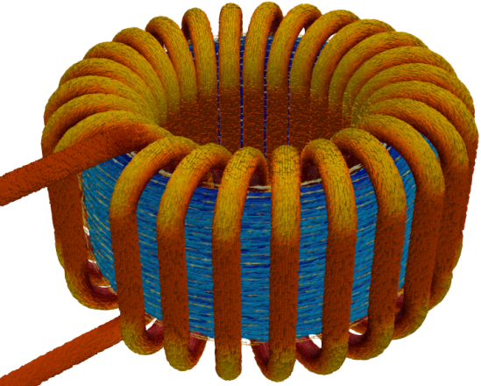
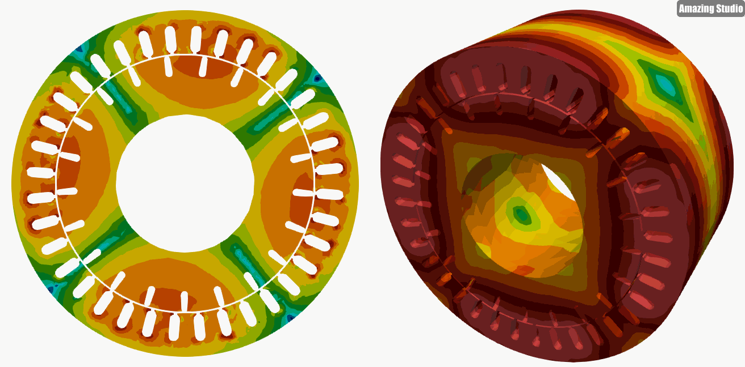

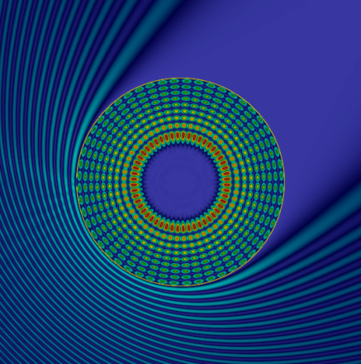
Intellectual Merits
Basic Features:
  Learning and visualizing concepts;
  Conducting virtual experiments;
  Performing simulations of EM fields.
Advanced Features:
  Full wave simulation methods;
  Multiphysics modeling capabilities;
  An online/mobile computational tool;
  High-performance computing.
Notes:
Upon completion, the playground will offer basic learning features like the visualization of EM concepts, conducting basic EM experiments, and simulating interactions between fields and materials. It will also offer advanced features in its more mature phase, which include full wave numerical simulations, multiphysics modeling capabilities, online or mobile demonstrations, and high-performance computing capabilities.

Slide 11
Who cares
Students
Visualize Invisible
Enhance Understanding
Fun to Play
Instructors
Assist Instruction
Motivate Students
Tool for Term Project
Designers
Proof of Concept
Optimize Design
Quick Demonstration
Notes:
If the EM playground is delivered to the end users, many can benefit from it. The students can use it to learn EM physics more easily and intuitively; instructors can use it as an instruction tool and project designer; Other professionals and engineering designers can use it for a fast proof-of-concept and demonstration.

Slide 12
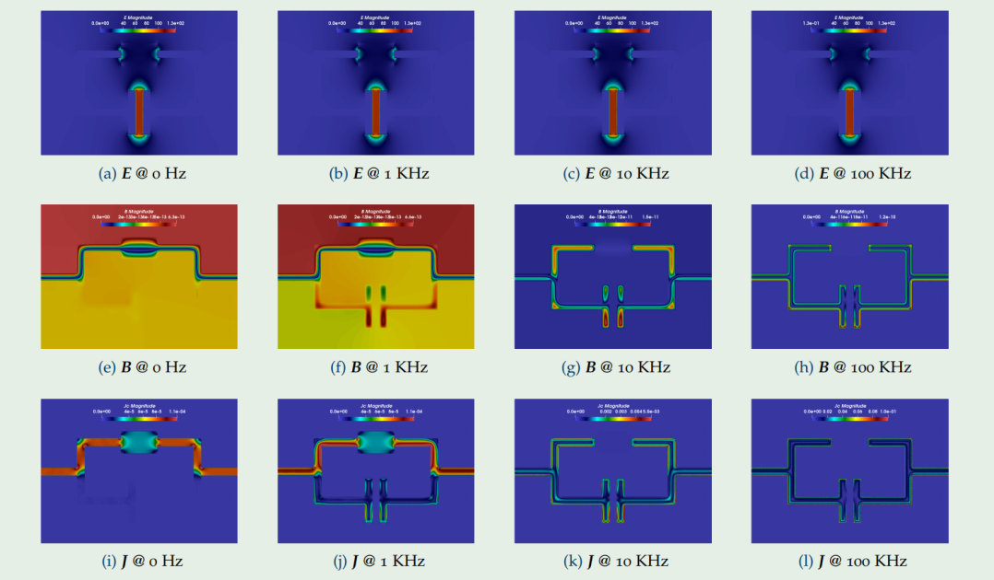

Broader Impact
As an Educational Tool:
  Help in understanding;
  Stimulate interests;
  Prepare for advanced study;
As a Simulation Tool:
  Design assessment;
  Design optimization;
  Design demonstration;
As a Research Project:
  Undergraduate research;
  Graduate preparation;
what difference will it make?
Notes:
As a result, the successful development of such an EM virtual playground will have a very broad impact as an educational tool, a simulation tool, and a research tool, and is expected to impact STEM students, instructors, and professionals over a very wide spectrum.

Slide 13
Learning Opportunities
Electromagnetic Theories
Electromagnetic Applications
Numerical Analysis: Mie, FDTD, FEM, MoM
Python Implementations
High-Performance Computing: MPI, OpenMP, GPU-CUDA
Computer Graphics: Geometrical Modeling
Computer Visualization: GUI, VTK
Notes:
This VIP project, by itself, also provide abundant learning opportunities. Because of its interdisciplinary nature, many knowledges are required for its development, including EM theory, application, numerical analysis, program implementation, high-performance computing, and computer visualization.

Slide 14
What are the risk
Steep learning curve:
Many materials to learn
Interdisciplinary:
Collaboration across disciplines
Notes:
In this project, we try to minimize and control the risks, which mainly come from the steep learning curve and interdisciplinary collaboration. We plan to minimize the risks by working closely together as a team. We have dedicated time for team-work and weekly VIP meeting for discussions.

Slide 15
How much will it Cost
No Cost at the Beginning
Software implementation
Cost for Server
Online computing
High-performance computing
Time Cost
Abundant
Notes:
Due to its software development nature, there is nearly no cost at the initial stage of this project. When it evolves to a more advanced stage, a computing serve is needed to support online computing and high-performance computing. Most important cost comes from the time devoted in the project, which must be abundant.

Slide 16

How long will it take
A multi-year project;
Progressive and cumulative.
Milestones and assessments
Milestones:
  A simple GUI and the 1st EM virtual experiment;
  Experiments that cover the undergraduate EM course;
  Enhanced visualization capabilities;
  More advanced numerical methods in EM simulations;
  Online tool access;
Assessments
  Benchmark with theoretical results and commercial tools;
  Release to the students in EM class for feedback;
  Post online for broader access and evaluation.
Notes:
This project is designed as a cumulative multi-year project, with specific milestones and assessment measures well defined, as shown on this slide. Specifically, for the current stage, we are working on putting together a simple graphic user interface (GUI) and implement the first EM virtual experiment. As the project evolves, more experiments and capabilities will be implemented.

Slide 17
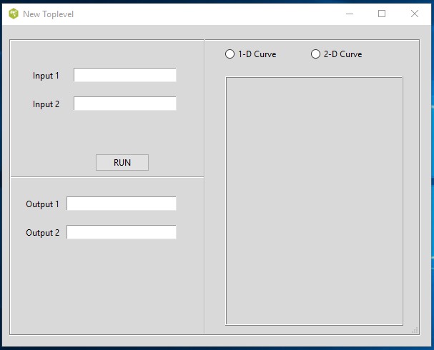
Current Project Progress
GUI Development: by Javid
Goals
Design and implementation of the graphical user interface (GUI);
The GUI should be simple, user friendly, and allow users to set up virtual experiments and visualize the results in 1-D, 2-D, and 3-D.
Notes:
The next few slides demonstrate our current progress on this project. Five team members are working on different parts of the project, collaboratively. Javid takes care of the GUI development, which allow users to set up virtual experiments and visualize the results.

Slide 18
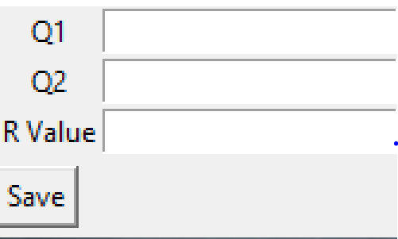
Current Project Progress
Experimental Settings and Inputs: by Nana-Akua
Goals
Develop codes to provide the GUI with information to set up the virtual experiment and specify how the results be displayed in 1-D, 2-D, and/or 3-D;
Implement a function to save the experimental settings into a text file for other sections or users to access.
Notes:
Nana-Akua is in charge of the experimental settings and inputs. This involves the development of codes to provide the GUI with information to set up the virtual experiment and specify how the results be displayed and implement a function to save the experimental settings into a text file for other sections or users to access.

Slide 19
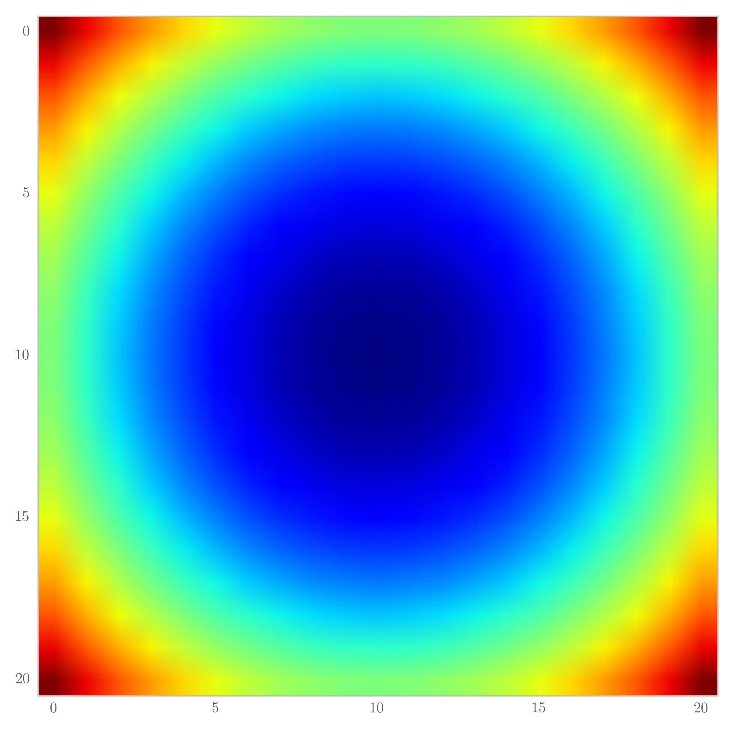
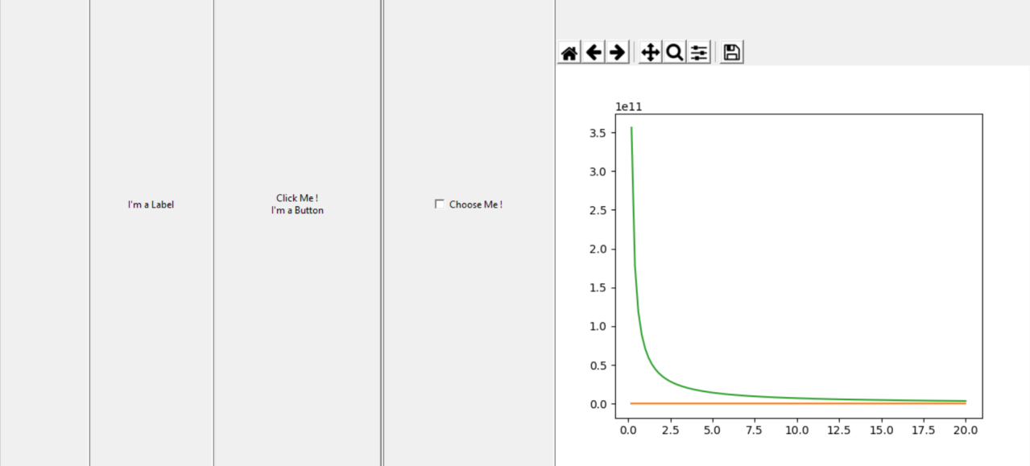
Current Project Progress
Visualization of EM fields in 1-D & 2-D: by Olaide & Oluwa
Goals
Write programs that performs the field calculation;
Develop codes to visualize the 1-D curve and 2-D colormap of the EM fields;
Design a unified window to show different figures for a more efficient display.
Notes:
The third part is the implementation of field visualization, which is conducted by Olaide and Oluwa. In this part, a program that performs a simple field calculation is to be implemented, and visualization functions of 1-D curve and 2-D colormap is being developed.

Slide 20
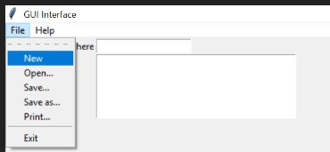
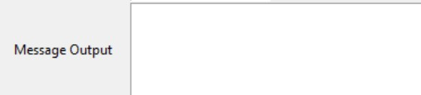
Current Project Progress
Tool Menu and Message Box: by Faith
Goals
Develop menus to provide access to software functions to create, open, save, and close a project (experiment);
Design a message box to output the run-time information provided by the engine.
Notes:
The last part is the tool menu and message box design, done by Faith, who is developing menus to provide access to software functions to create, open, save, and close a project; and designing a message box to output the run-time information provided by the engine.

